Slide 1
HPE CTY - Fault Detection and Classification in IUF using Log Analysis
Vellore Institute of Technology
CTY Members - Aayushi Agrawal, Bhavya Sree E, Lakshay Roodkee, Divyanshi Gupta, Hemanth Kumar Singh
CTY Mentor - Dr. Jayakumar Sadhasivam
HPE DIR - Mr. Amarnath Chilumukuru
HPE Mentor - Mr.Rajesh Ranganathan, Mr.Madhusuthanan
27-06-2024

Slide 2
Problem Statement
Objective: To implement machine learning for accurately identifying and categorizing faults in the IUF using log analysis
Background: The Install and Upgrade Framework (IUF) is a critical component used to manage the installation and upgrading of software and systems. Ensuring the smooth operation of the IUF is vital for maintaining system integrity and performance. Faults or issues during the installation and upgrade processes can lead to significant disruptions, necessitating an automated and efficient approach to fault detection and categorization.
Challenges:
Volume and Variety of Logs
Complexity of Faults
Timeliness.

Slide 3
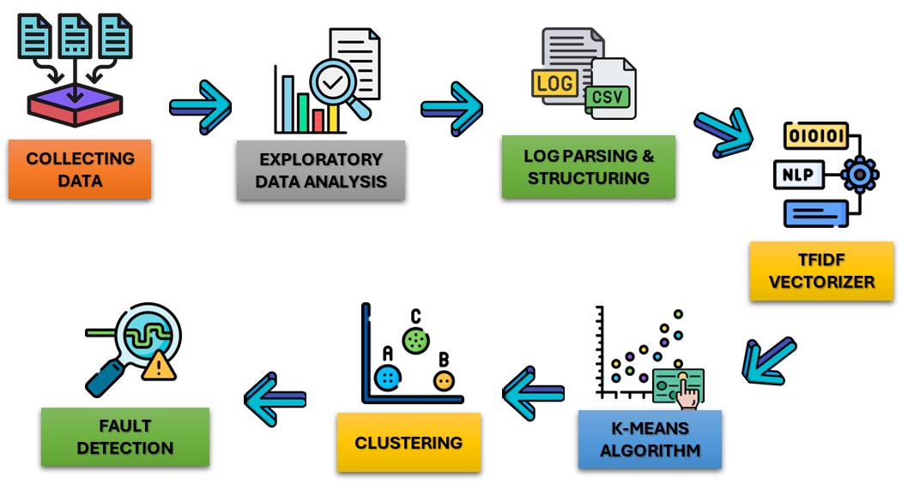
PROJECT WORKFLOW ARCHITECTURE

Slide 4
PROJECT PLAN, LEARNINGS, CHALLENGES
Training
Working with IUF
Studying existing techniques for log analysis
Execution with Actual Data
Learnings
Covered essential tools and techniques including Pandas, NumPy, Matplotlib, Seaborn, Scikit-learn, TF-IDF, unsupervised learning & clustering.
Explored research papers on state-of-the-art machine learning approaches for log analysis.
Developed a solid foundation in data preprocessing, visualization, machine learning techniques and algorithms required for advanced log analysis.
Challenges
Preprocessing of unstructured logs
Choosing the suitable parameters to train the model
Memory constraints
Pattern Identification of faults

Slide 5
Research Work
Papers and Literature -
Machine Learning for Log Analysis : Link :- https://www.youtube.com/watch?v=5aovmNf3s2Q
Automatic Log Analysis using Machine Learning
Build Log Classifier :https://aicoe-aiops.github.io/ocp-ci-analysis/notebooks/data-sources/gcsweb-ci/build-logs/build_log_EDA.html
State of the Art - 3 literature Surveys
El-Masri, Diana et al. A systematic literature review on automated log abstraction techniques.
Information and Software Technology 122 (2020) Landauer, Max, et al. System log clustering approaches for cyber security applications: A survey. Computers & Security 92 (2020).
Zhu, Jieming, et al. Tools and benchmarks for automated log parsing. IEEE/ACM 41st ICSE-SEIP. ΙΕΕΕ, 2019.
NLP for Log Parsing - 2 papers
Nedelkoski, Sasho, et al. Self-Supervised Log Parsing. arXiv preprint arXiv: 2003.07905 (2020).
Aussel, Nicolas, et al. Improving performances of log mining for anomaly prediction through NLP-based log parsing. IEEE, 2018.

Slide 6
Research Study Inferences:
Understood the general structure of logs.
Machine learning can automate fault detection in the Install and Upgrade Framework (IUF).
Diverse log formats and dynamic system changes present challenges for accurate fault categorization.
Automated log analysis improves predictive maintenance and system integrity.
Exploratory Data Analysis (EDA) aids in understanding fault patterns within IUF logs.
Log abstraction techniques streamline log volume while retaining essential fault details.
Clustering algorithms enhance fault detection by grouping similar log entries.
Standardized benchmarks are necessary for evaluating the effectiveness of log parsing tools.
Self-supervised log parsing can improve fault detection accuracy without extensive labeled data.
NLP-based log parsing enhances the identification and categorization of faults.
Integrating NLP with traditional log analysis methods results in better fault categorization outcomes.

Slide 7
Characteristics of ocp-ci Logs
The size of the log file is equivalent to the blob size in GCP.
The CI logs are well structured.
The same job runs multiple times, which enables us to compare multiple versions of the same log file
These logs have a fixed start and fixed end, similar to IUF logs.
TF-IDF can be applied to these CI logs as each build.log file can have its separate document.
Similar to IUF logs, each log can be treated as a different entity in TF-IDF (install.log and build.log).
These are the driving factors behind choosing these logs:
The pass/fail status of the logs is identifiable.
It is possible to determine when they begin and end.
Duration of the job run is known.
The size of the logs is known.

Slide 8
How HPE logs are similar to openshift-ci build logs
Similarities:
Both logs include timestamps.
Both logs detail each step of the build process.
Both logs include success/failure indicators and messages.
Both logs are structured to provide a clear sequence of events and actions taken during the build process.

Slide 9
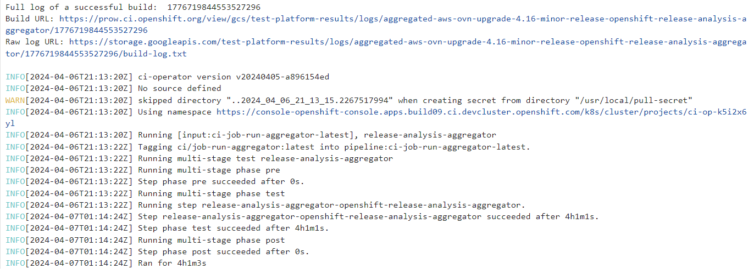
Working With openshift-ci build logs
Sample Logs :-

Slide 10
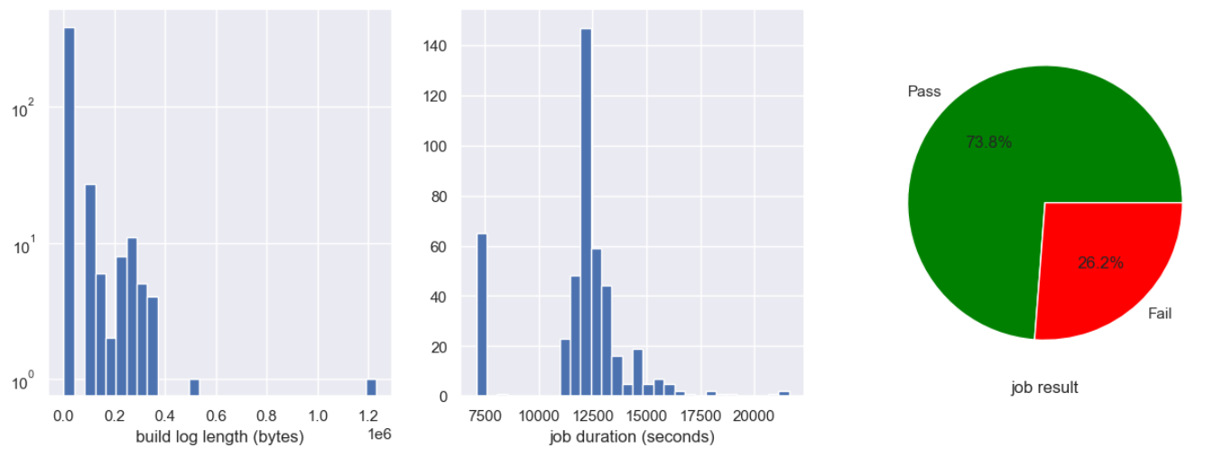
Working With openshift-ci build logs
Exploratory Data Analysis :- Graphical overview of the distribution

Slide 11
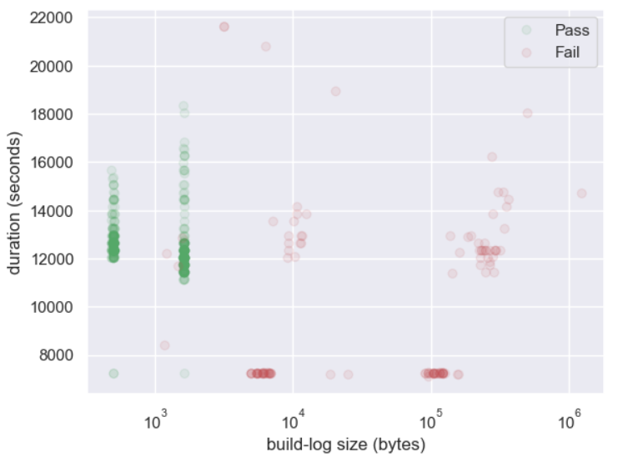
Working With openshift-ci build logs
Exploratory Data Analysis :-
Strong Correlation between build’s log size and result
Successful jobs have very consistent build log length
A build’s duration also has a relationship with the results: a duration under a certain threshold indicates a failure before tests could start, e.g. install or infrastructure issues

Slide 12
Working With openshift-ci build logs
Term Frequency Analysis :-
Contents of the log file can help us group jobs according to different types of failure.
TFIDF can be used to assign weights to each term which gives us an insight on the importance of the term.
We essentially discard all the time stamps, numbers and create a regex(regular expression) that considers only relevant log messages.

Slide 13
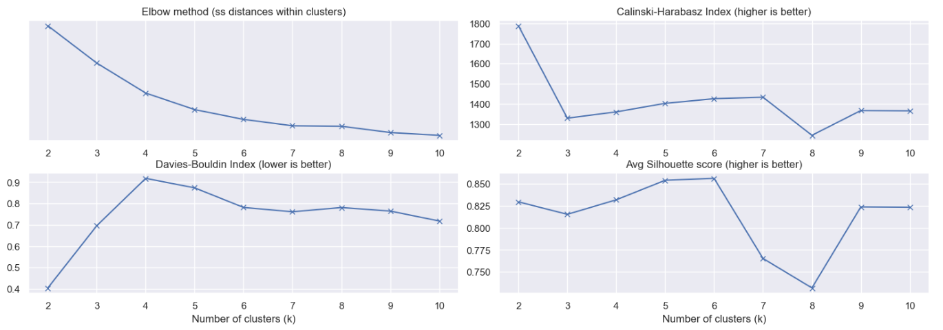
Working With openshift-ci build logs
K-Means Metrics
The vectors obtained are clustered using K-means
Metrics such as Calinski-Harabas index, Davies-Bouldin index, Average Silhouette score and elbow method helps us choose the K value.

Slide 14
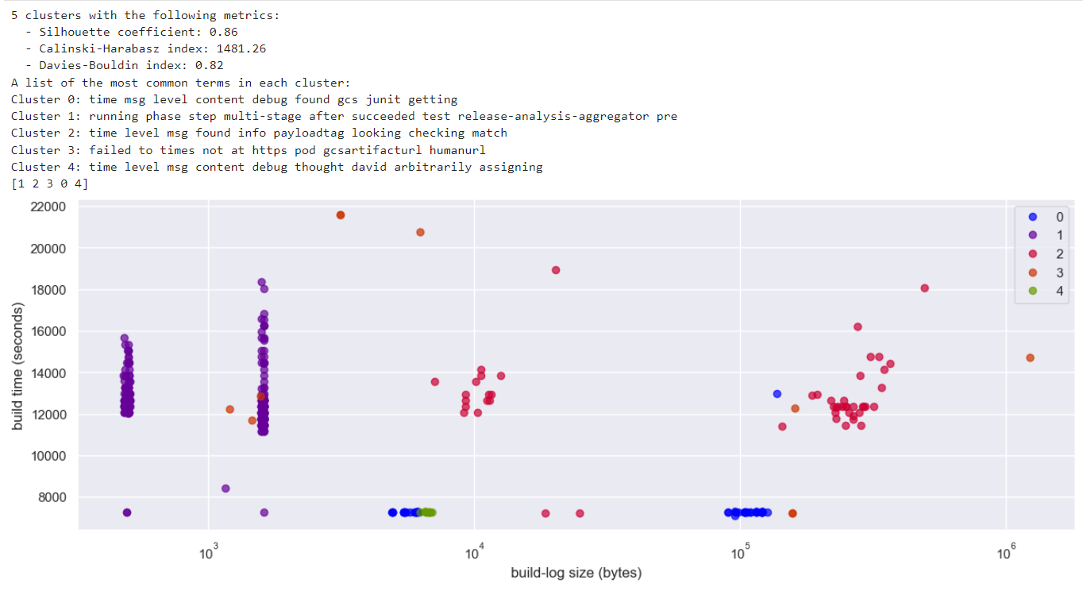
Clustering on openshift-ci build logs
To find the optimal value of K, we run k-means with different number of clusters, plot and examine the clusters’ silhouette for each k.

Slide 15
Inferences from openshift-ci build logs
Learnings
Content analysis does provide additional insight over just plain metadata (size and duration).
A bag-of-words technique, TF-IDF, can be successfully applied to CI logs.
The choice of which token pattern to use is important
Challenges
Choosing the token pattern for vectorization.
TFIDF didn’t provide results as expected.
Avoid overfitting
Choosing the number of clusters.

Slide 16
How were HPE logs different from openshift-ci build logs
Differences
CI logs | HPE logs
Start and end timestamps present in started.json and ended.json in structured format. | Start and end timestamps present in the record-time-template file. It could also be extracted from install.log itself
Simple structure. | Complex structure with many objects
ended.json contained the information on whether the job succeeded or failed. | No explicit mention of the success or failure.But can be inferred from the log file.

Slide 17
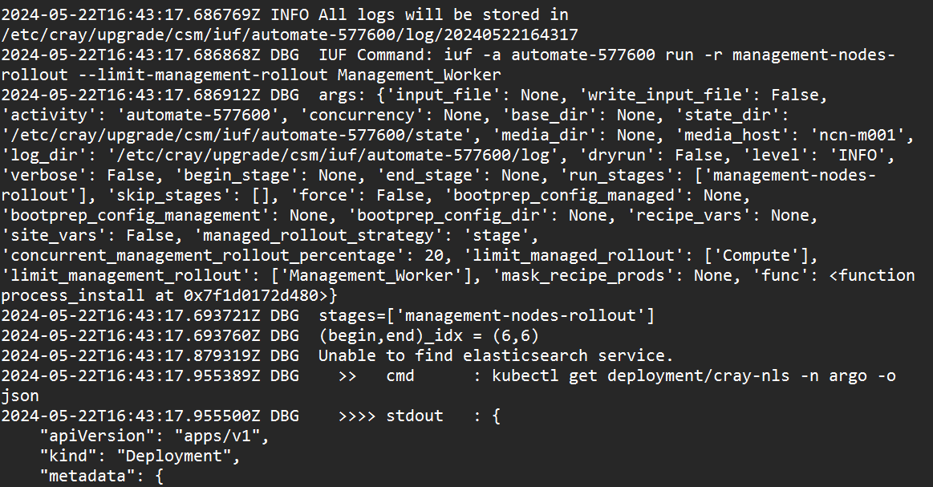
Working with IUF Logs
Sample Logs

Slide 18
DEMO
Demo Objective
To showcase our findings from the HPE log events.
Establishing relationship between log messages and IUF process result.
Leveraging machine learning algorithms for log analysis.
Providing actionable insights in detecting anomalies further.
Enhancing the reliability and efficiency of install and upgrade processes.

Slide 19
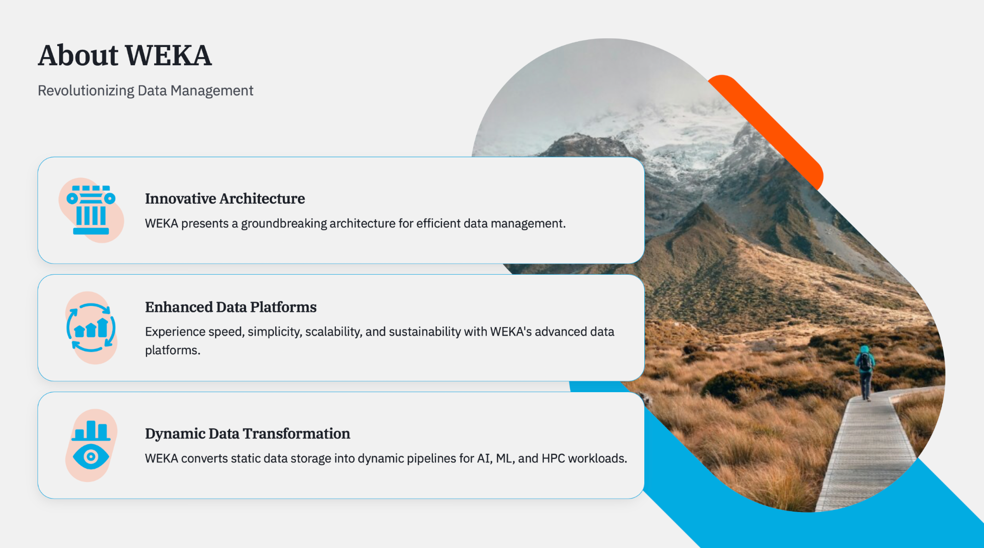

Slide 20
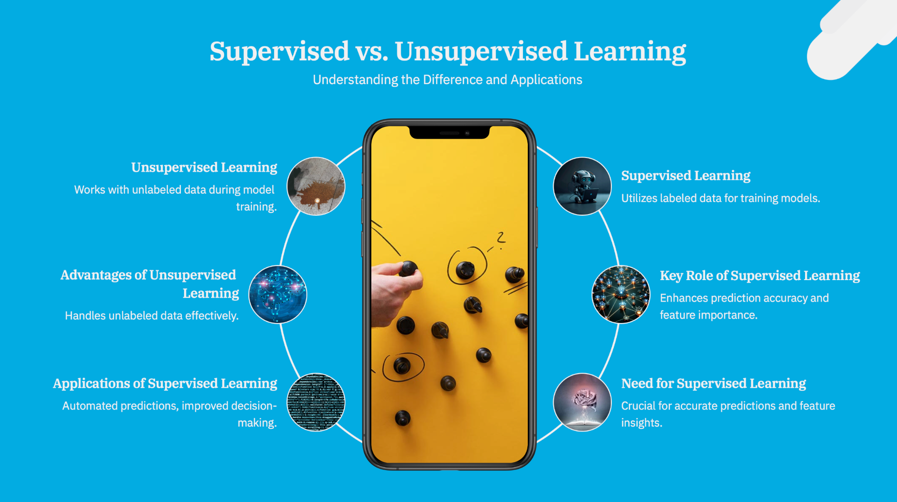

Slide 21
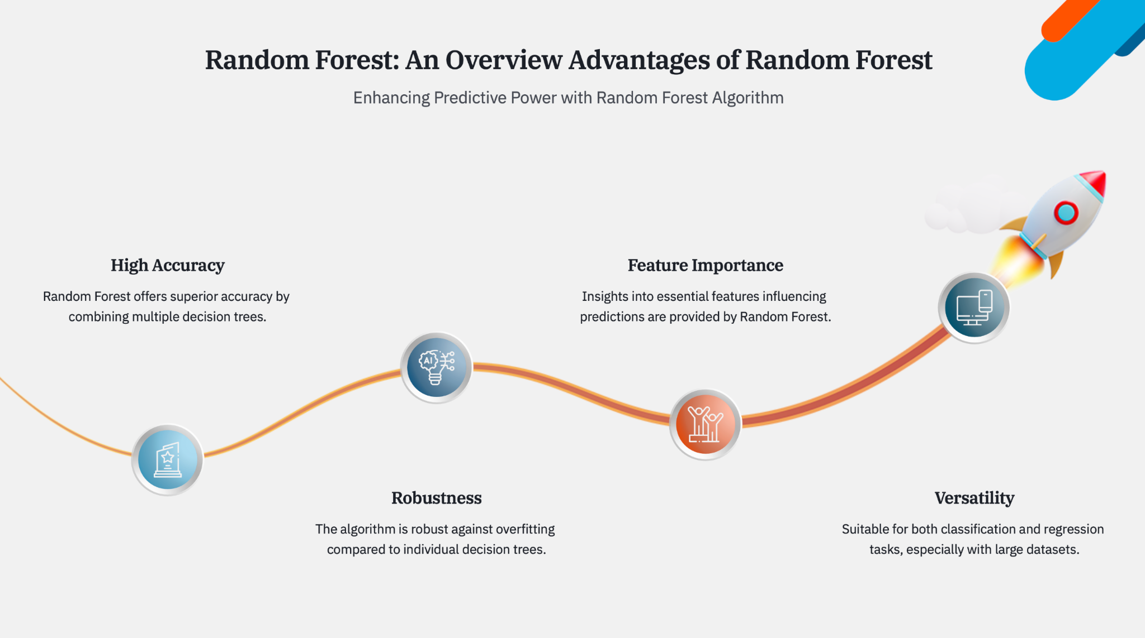

Slide 22
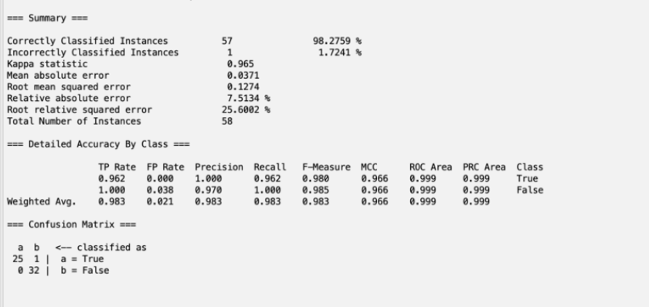
Weka Simulation

Slide 23
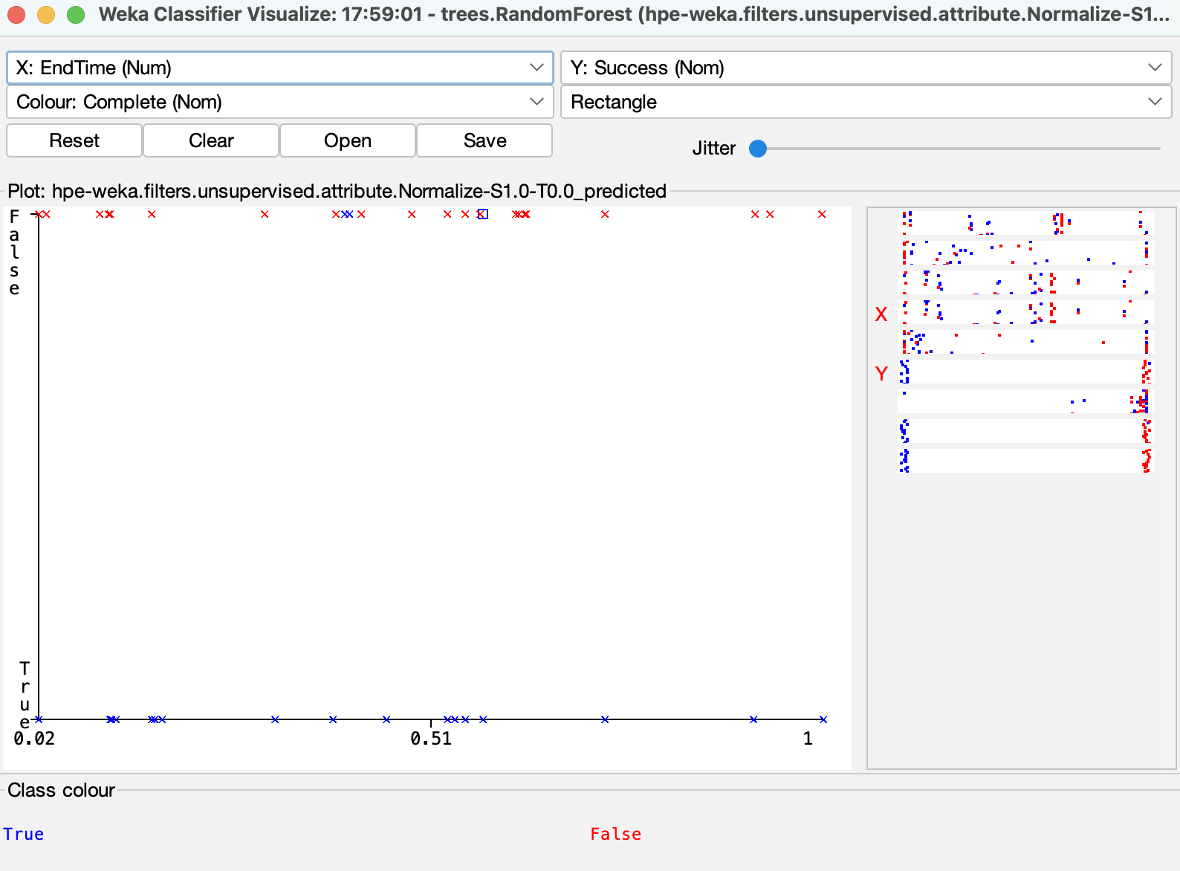
Weka Graph Simulation

Slide 24
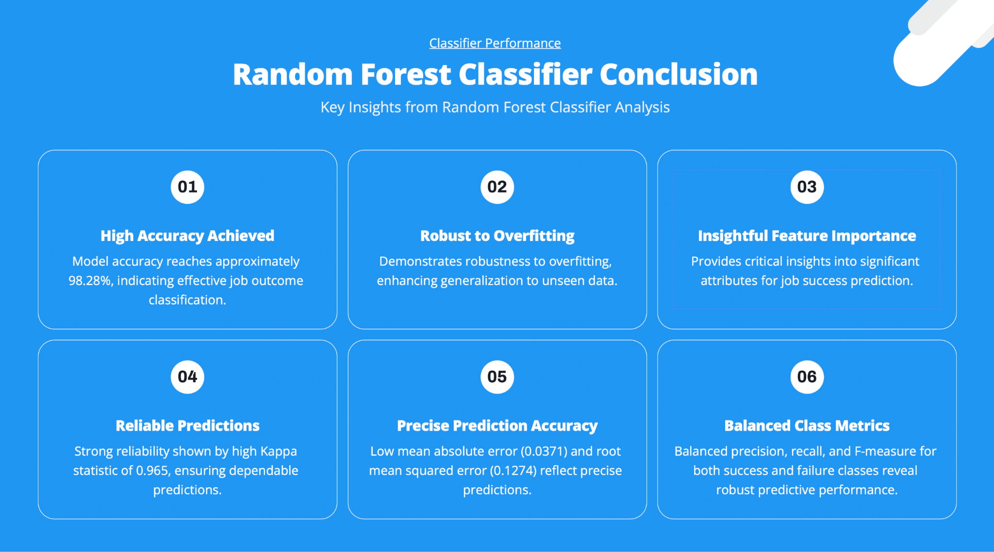

Slide 25
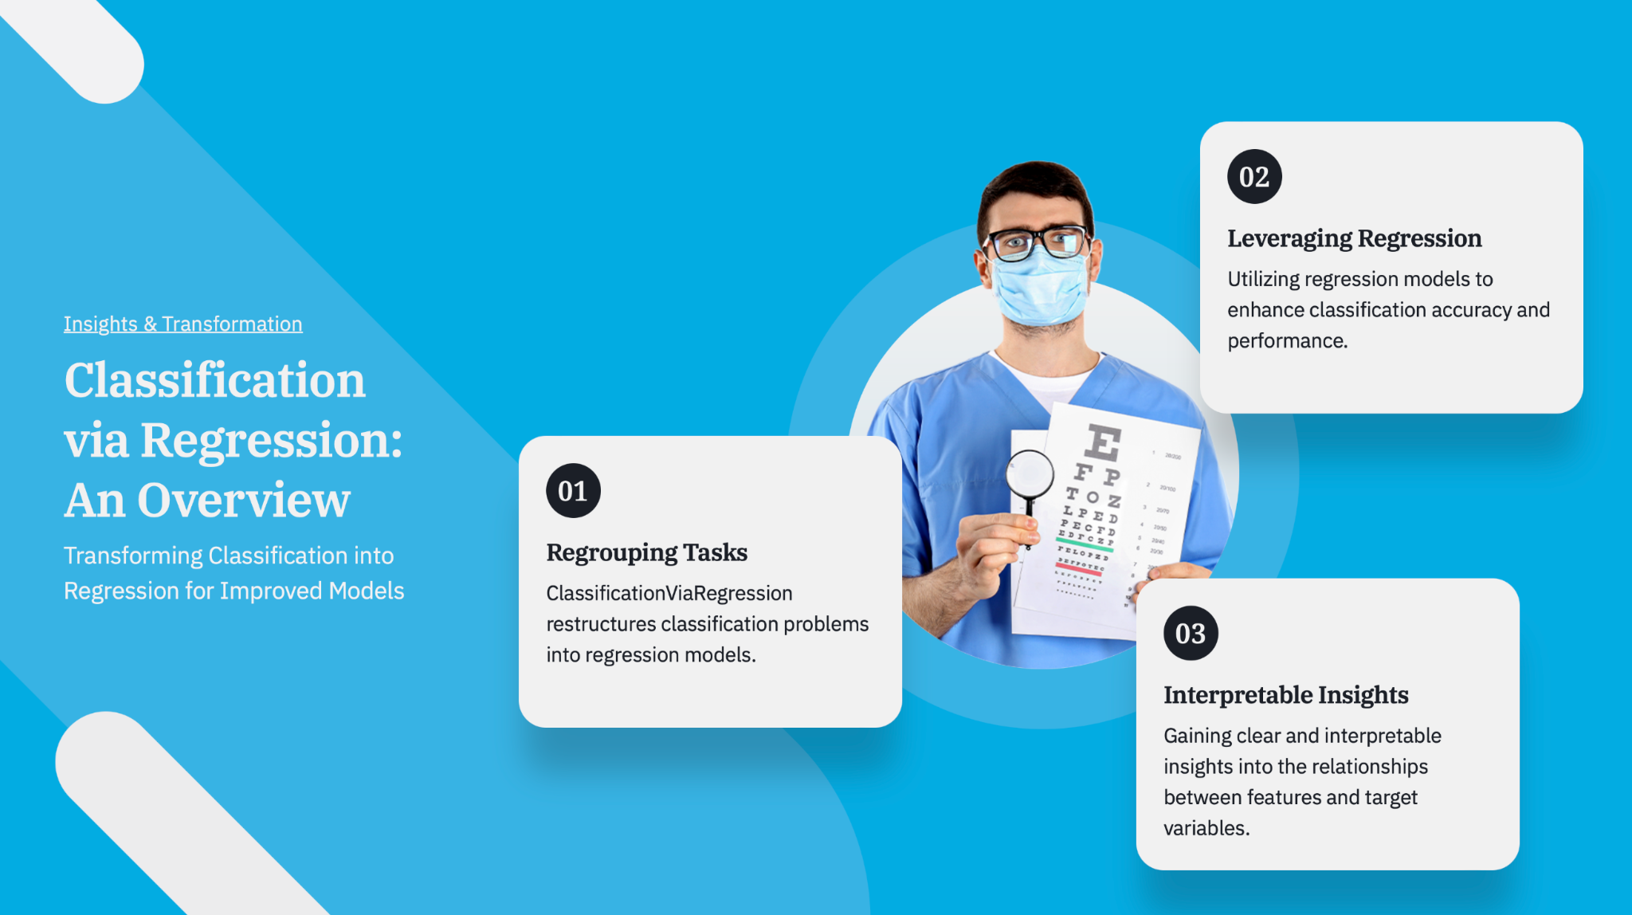

Slide 26
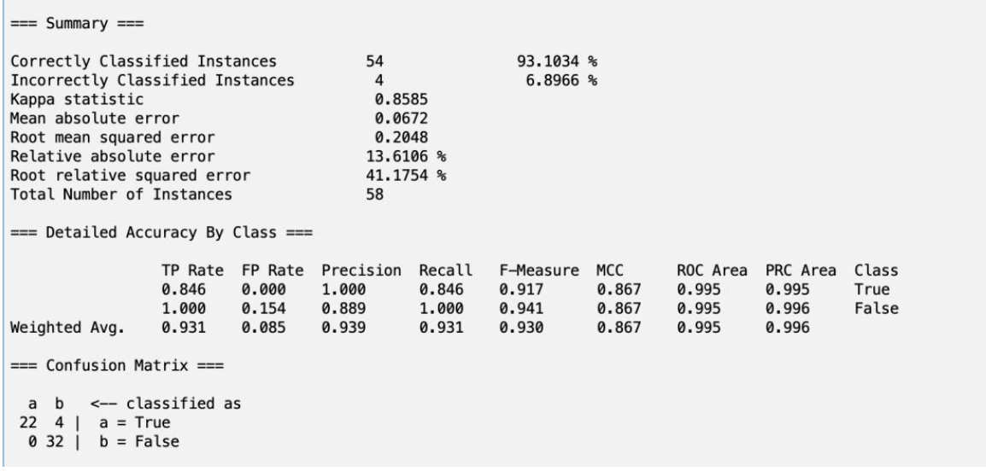
Weka Simulation

Slide 27
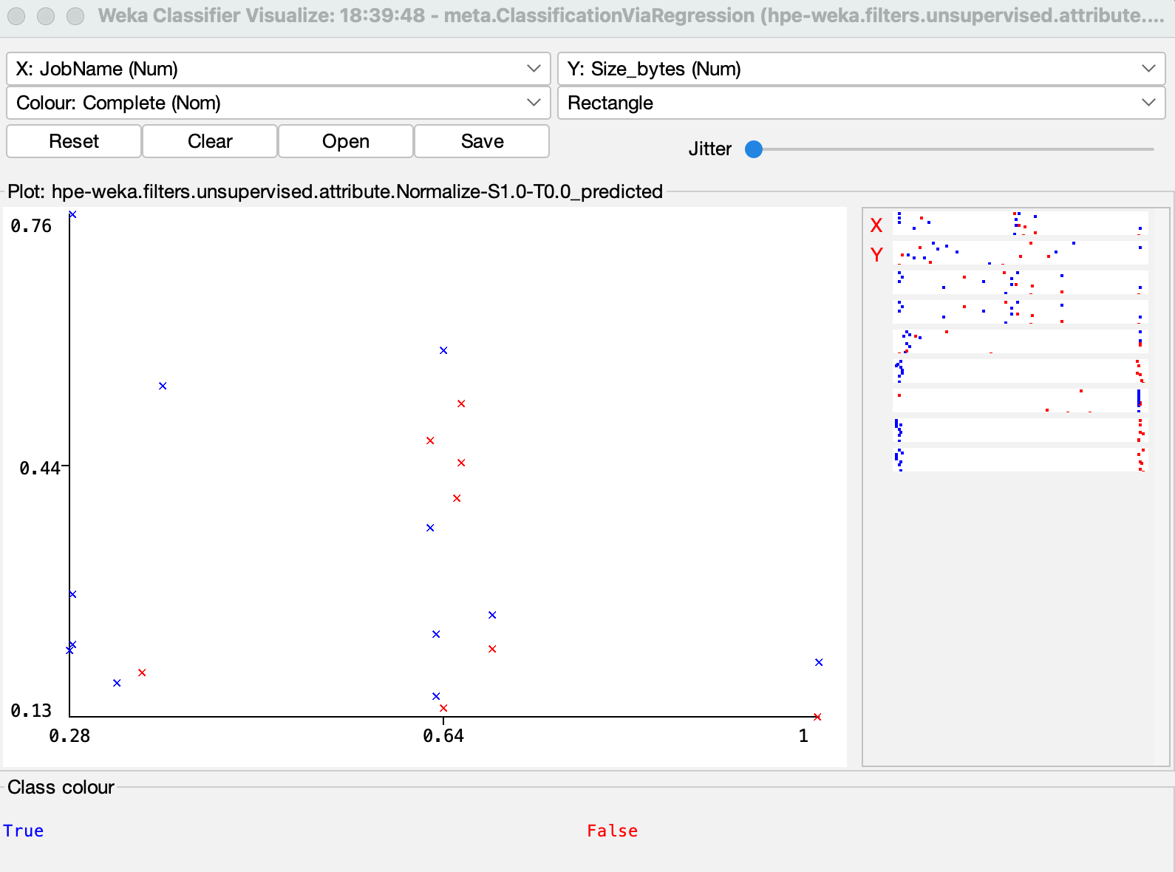
Weka Graph Simulation

Slide 28
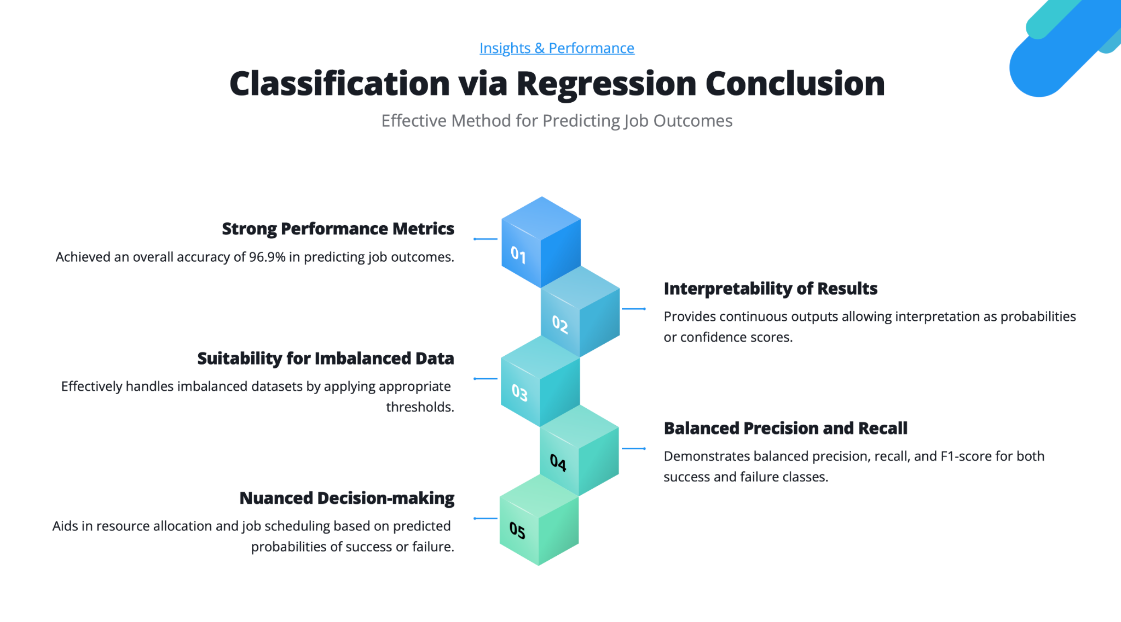

Slide 29
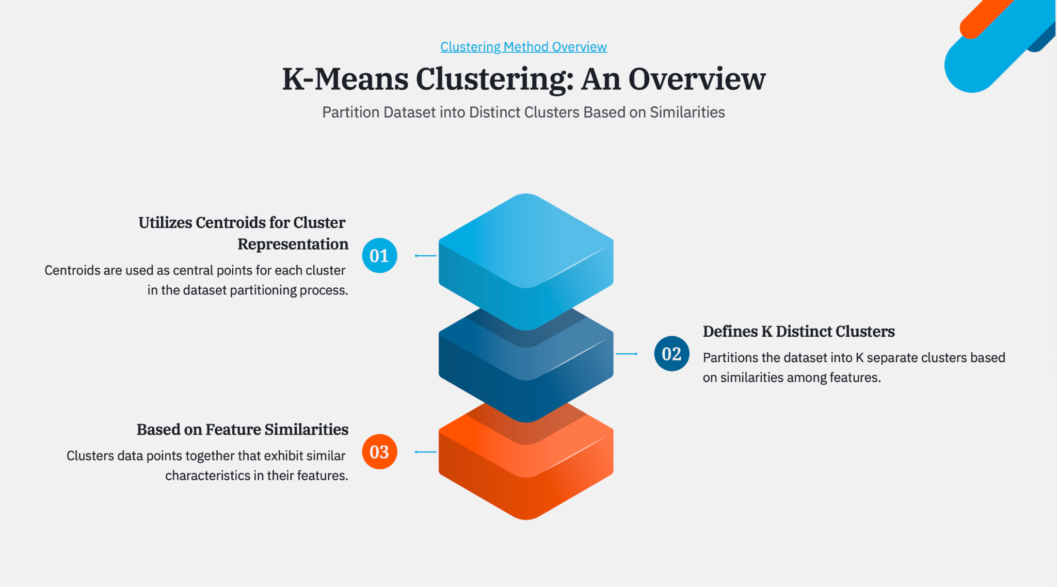

Slide 30
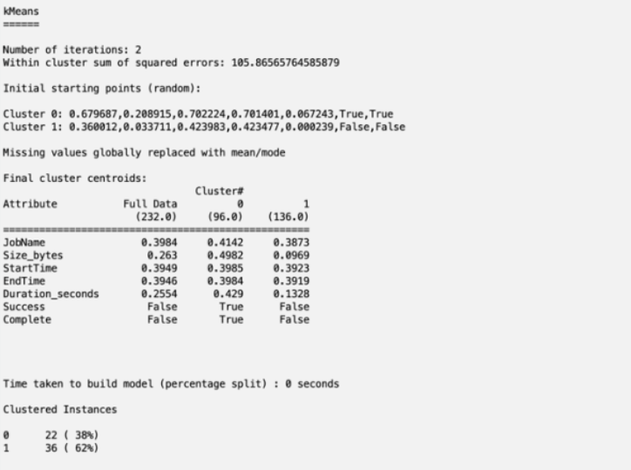
Weka Simulation

Slide 31
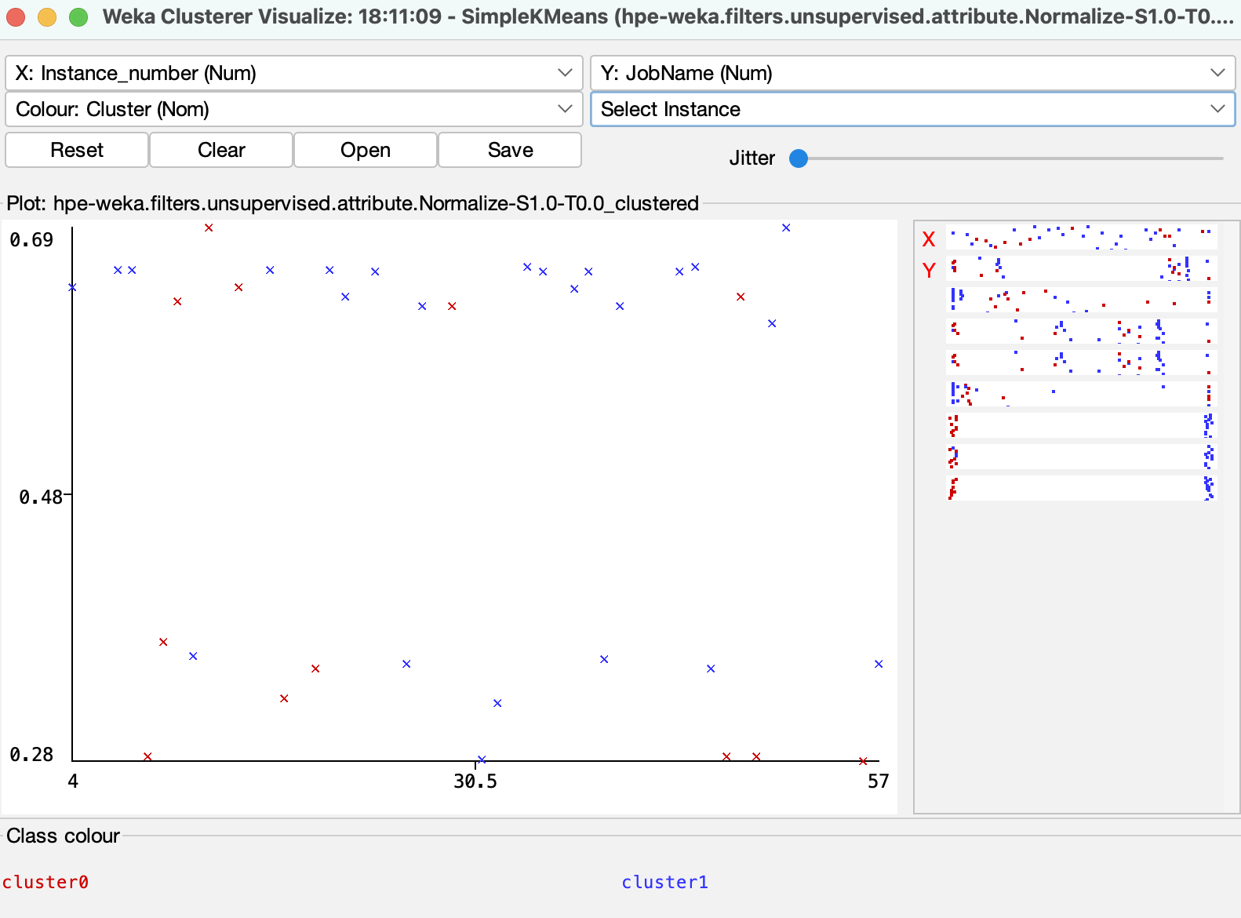
Weka Graph Simulation

Slide 32
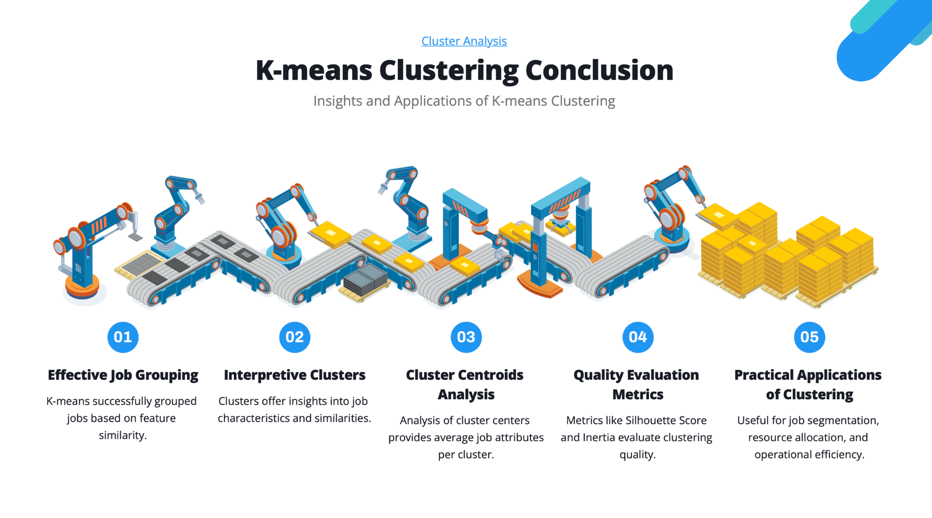

Slide 33
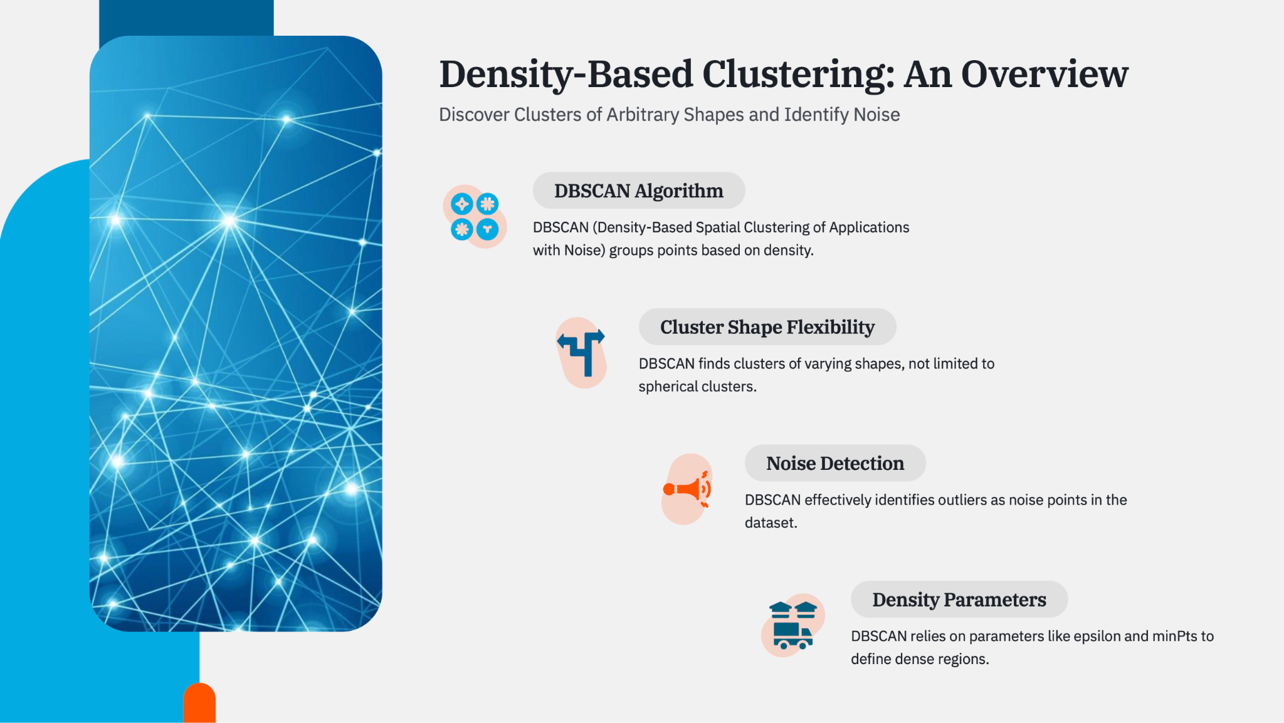

Slide 34
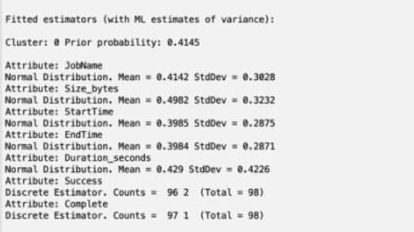
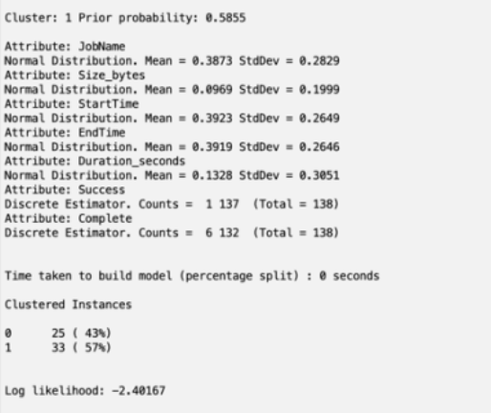
Weka Simulation

Slide 35
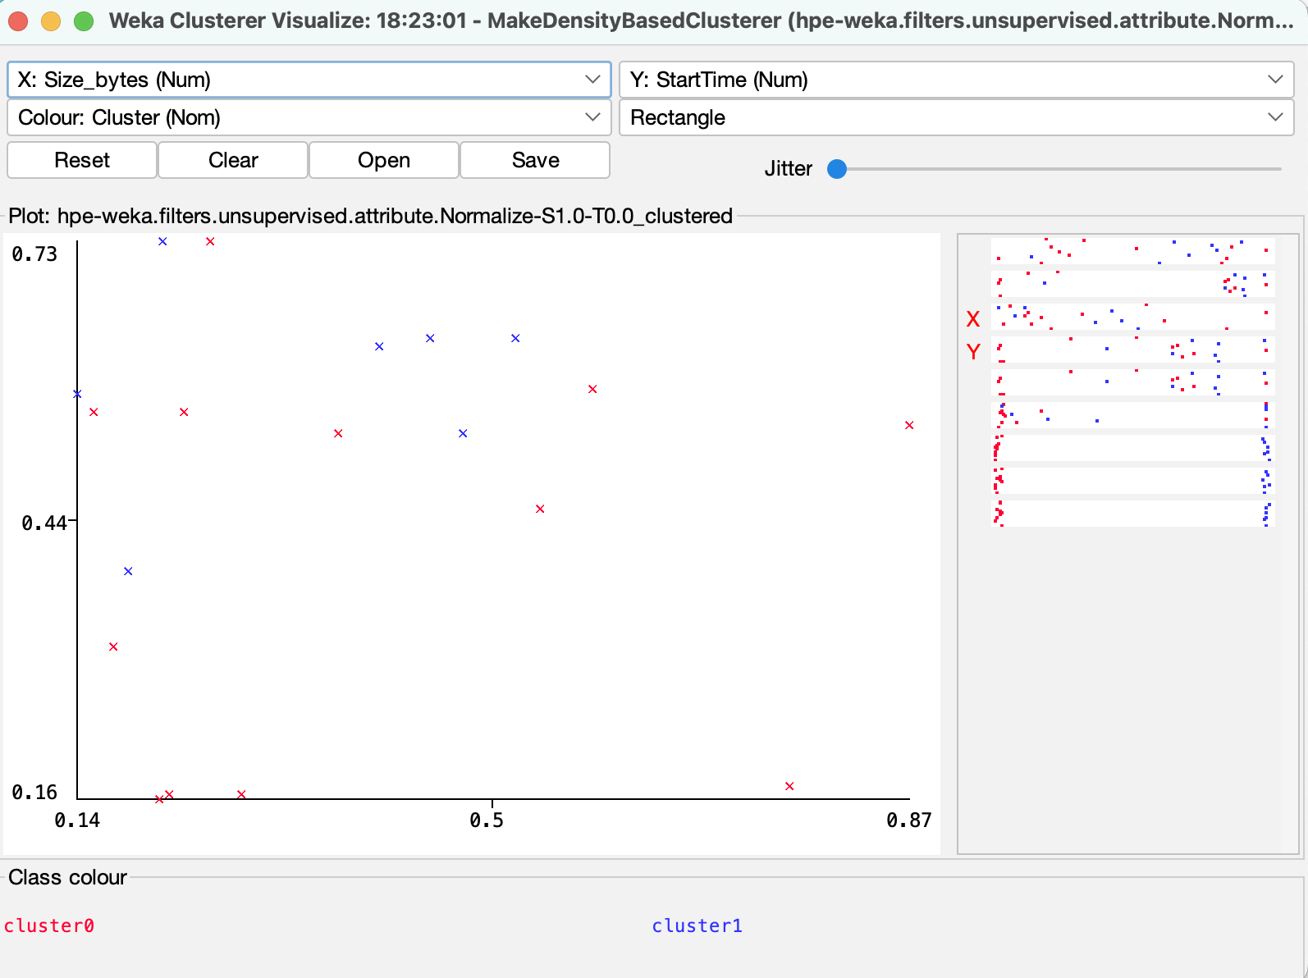
Weka Graph Simulation

Slide 36
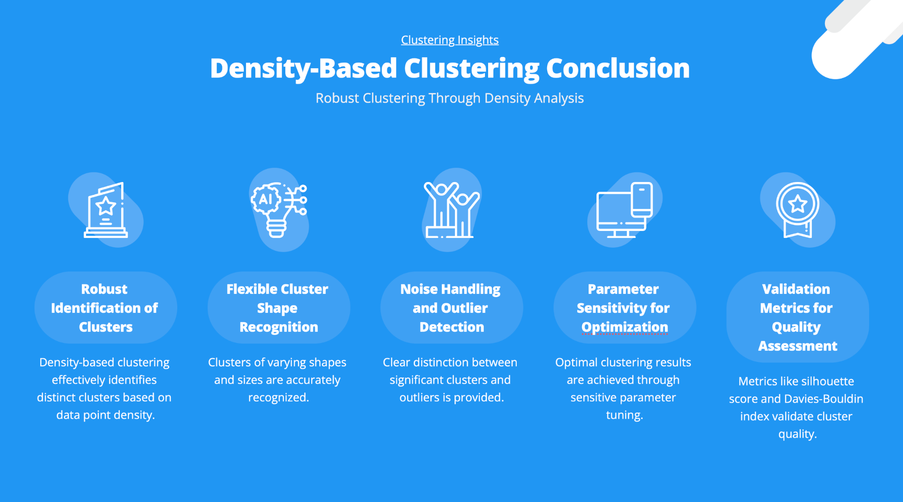

Slide 37
NEXT STEPS
Use efficient log parsers for structuring logs.
Try to extract more features from the log data.
Map the log events with event IDs for better identification of faults.
Implement more sophisticated text preprocessing techniques, such as lemmatization and stemming, to enhance the quality of the TF-IDF vectors.
Explore other unsupervised learning techniques- association and dimensionality reduction.
Use deep learning leveraging neural networks for advanced log analysis and anomaly detection and classification
Github repository Link

Slide 38
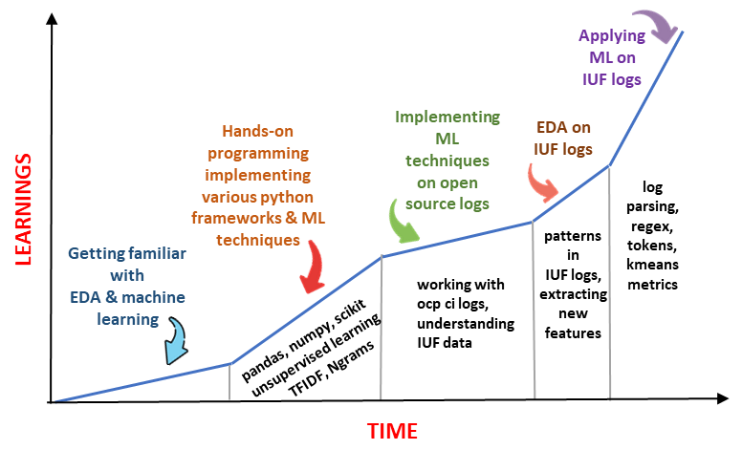
The learning curve of our CTY Project

Slide 39
THANK YOU

